Slide 1
ECC
Instructor: Robert Utterback
Lecture 10

Slide 2
Review
Combinational logic:
A: compute the same output given the same input
B: value depends on the inputs as well as the current contents of the memory
C: compute the # of combinations of a given set of elements
Notes:
A

Slide 3
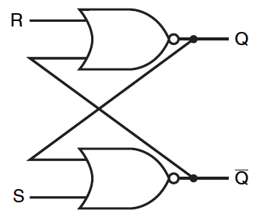
Review
A: A latch
B: A flip-flop
Notes:
It’s an S-R latch. Latches are asynchronous: Output changes soon after input changes
Flip-flops are synchronous: Output changes at the clock edge
A latch can be clocked or unclocked. The first S-R latch was unclocked and just changed whenever the input changed.
If clccked, it changes when the clock is asserted/high.

Slide 4
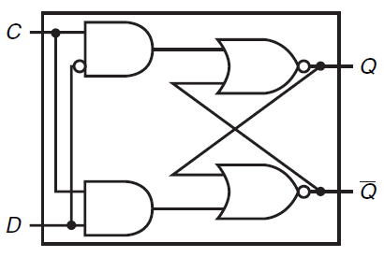
Review
A: D-Flip-Flop
B: S-R Flip-flop
C: D-Latch
D: None of the above
Notes:
D-latch. Has a clock input, but still changes as long as clock is high. MUST be clock edge to be a fli—flop.

Slide 5
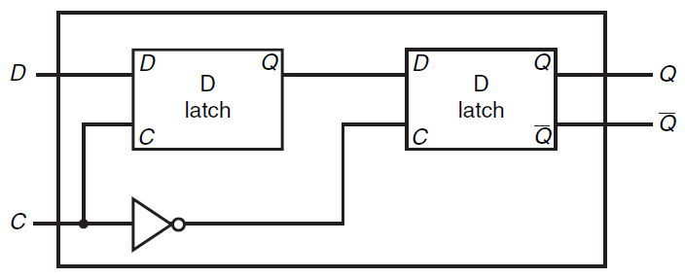
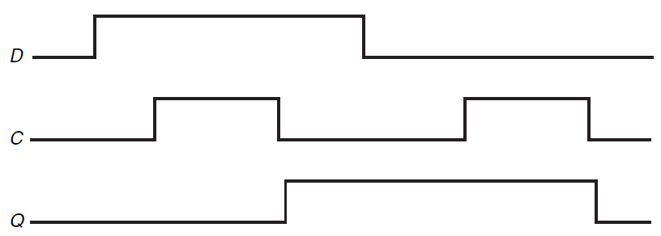
D Flip Flop
D Flip Flop with a Falling-Edge Trigger

Slide 6
Review
Difference between SRAM and DRAM?
Notes:
S = Static, D = dynamic. D requires power to constantly refresh or you lose the value. Note that SRAM still loses the value without power, but as long as power is supplied the value does not need to be refreshed. SRAM is fast but costly. DRAM is slow but cheaper and denser.

Slide 7
Memory Errors
Large memories have errors!
Spontaneous corruption of data/crashes!

Slide 8
Parity Code
Count the number of ones in a word
1 for odd parity, 0 for even
Store a parity bit for every word
Calculate when writing
Check when reading
No match => error!

Slide 9
Error Detection Code
1-bit parity scheme
Assured to catch only 1 bit of error
2 (or any even #) can slip past
Cannot say which bit is wrong
Notes:
Technically any odd # can be detected, but the probability is fairly low of getting 3+.

Slide 10
Error Correction Codes (ECC)
Can correct certain errors
Requires more bits
7 bits for 64-bit word
8 bits for 128-bit word
Most computers use ECC for
Detection of 2 bits of error
Correction of 1 bit of error
Notes:
Look up “Hamming codes” if you’re interested. Even more important in hazardous environments, e.g., satellites in space!
Note: still not foolproof! But you will actually experience an error with astronomically low probability, but not zero!

Slide 11
Hamming Code
4 bits: 1101
Notes:
From https://www.cs.princeton.edu/courses/archive/spring17/cos126/assignments/hamming.html

Slide 12
Multiple parity checks, each circle
Notes:
From https://www.cs.princeton.edu/courses/archive/spring17/cos126/assignments/hamming.html

Slide 13
Notes:
From https://www.cs.princeton.edu/courses/archive/spring17/cos126/assignments/hamming.html

Slide 14
Hamming Code Correction
Notes:
From https://www.cs.princeton.edu/courses/archive/spring17/cos126/assignments/hamming.html
Tells us which bit got flipped!

Slide 15
Errors in Parity Bits
Sometimes the parity bits, not the data bits, get corrupted!
But only one parity check will fail
So we know which one got corrupted.
Notes:
From https://www.cs.princeton.edu/courses/archive/spring17/cos126/assignments/hamming.html

